Slide 1
Hardware Workshop One Fundamentals
Day 1 Start

Slide 2
Motivation
Have no spring/summer activities in ECE
Review some concepts learned in ECE110
Learn some new concepts for ECE212 & ECE231
Have some ideas about how to build and debug a circuit
Build something practical out of simple components
Get motivated to design/build on your own and have fun

Slide 3





Staff
Iris Wang - ECE 2T5
irisjiayi.wang@mail.utoronto.ca
Simon Xu - ECE 2T5
xiaofengsimon.xu@mail.utoronto.ca
Nicholas Mutlak - ECE 2T5
n.mutlak@mail.utoronto.ca
Shuntaro Wakamatsu - ECE 2T5
shuntaro.wakamatsu@mail.utoronto.ca
Ryan Seto - ECE 2T5
ryan.seto@mail.utoronto.ca

Slide 4
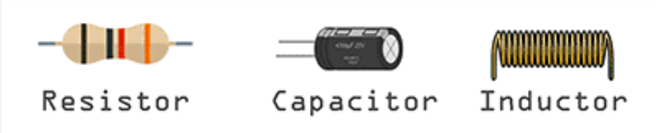
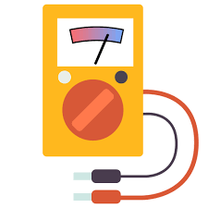
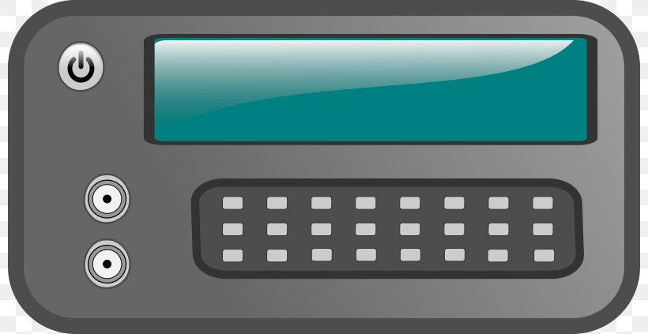
Hardware Workshop: (4 Day Program)
Phase One: Review of Ece110
Resistor, Capacitor, Inductor
Series and Parallel Circuits
Breadboard
Soldering
Digital Multimeter
Function Generator
Oscilloscope

Slide 5
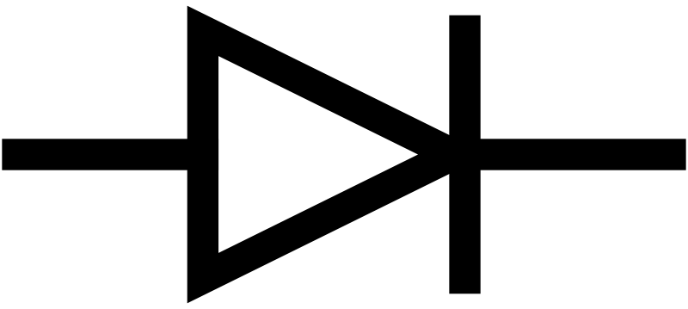
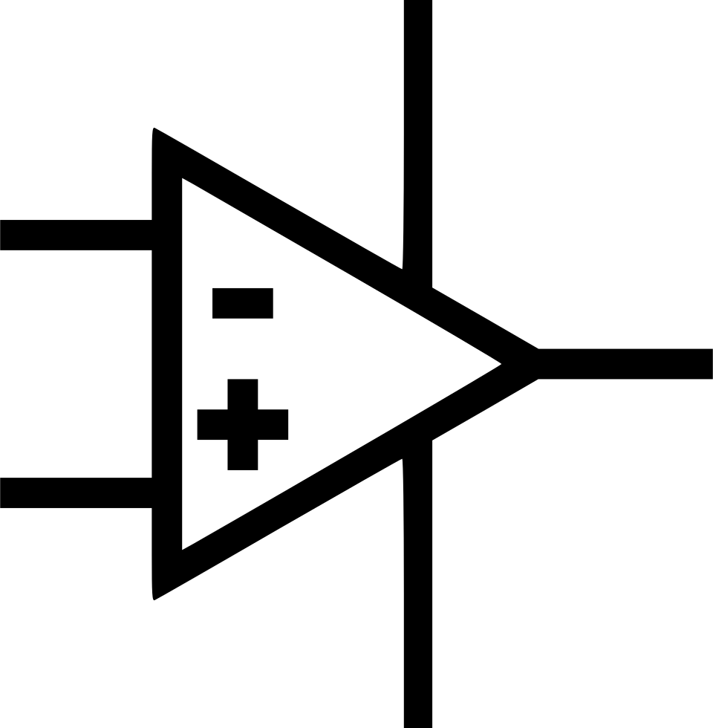
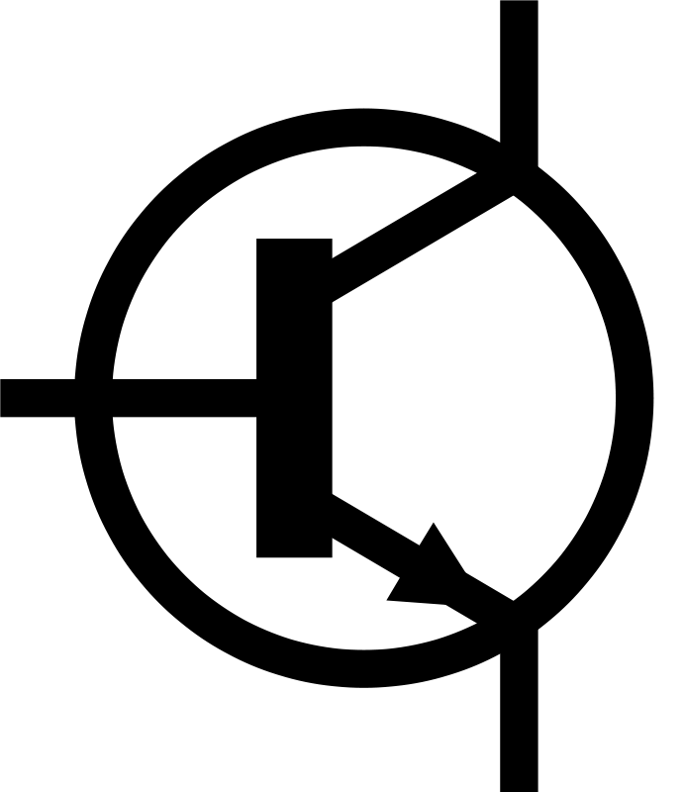
Hardware Workshop: (4 Day Program)
Phase Two: Introduction to Ece212/231
Semiconductor
Diode and LED
Types of Transistors
NPN and PNP Connections
Astable Multivibrator
Operational Amplifiers

Slide 6
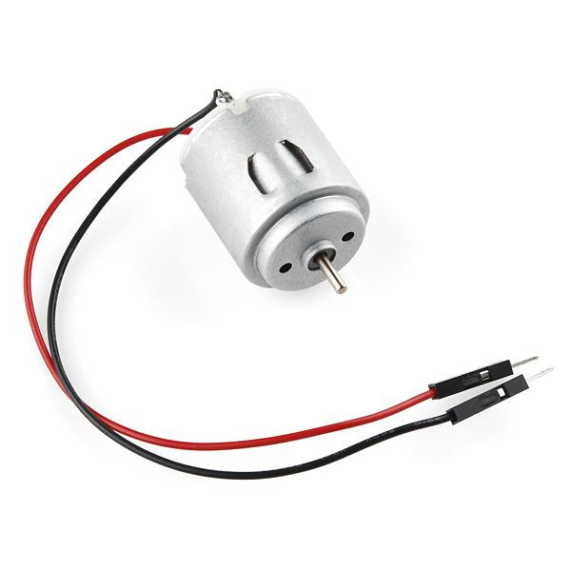
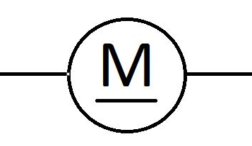
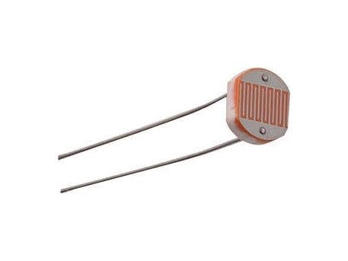
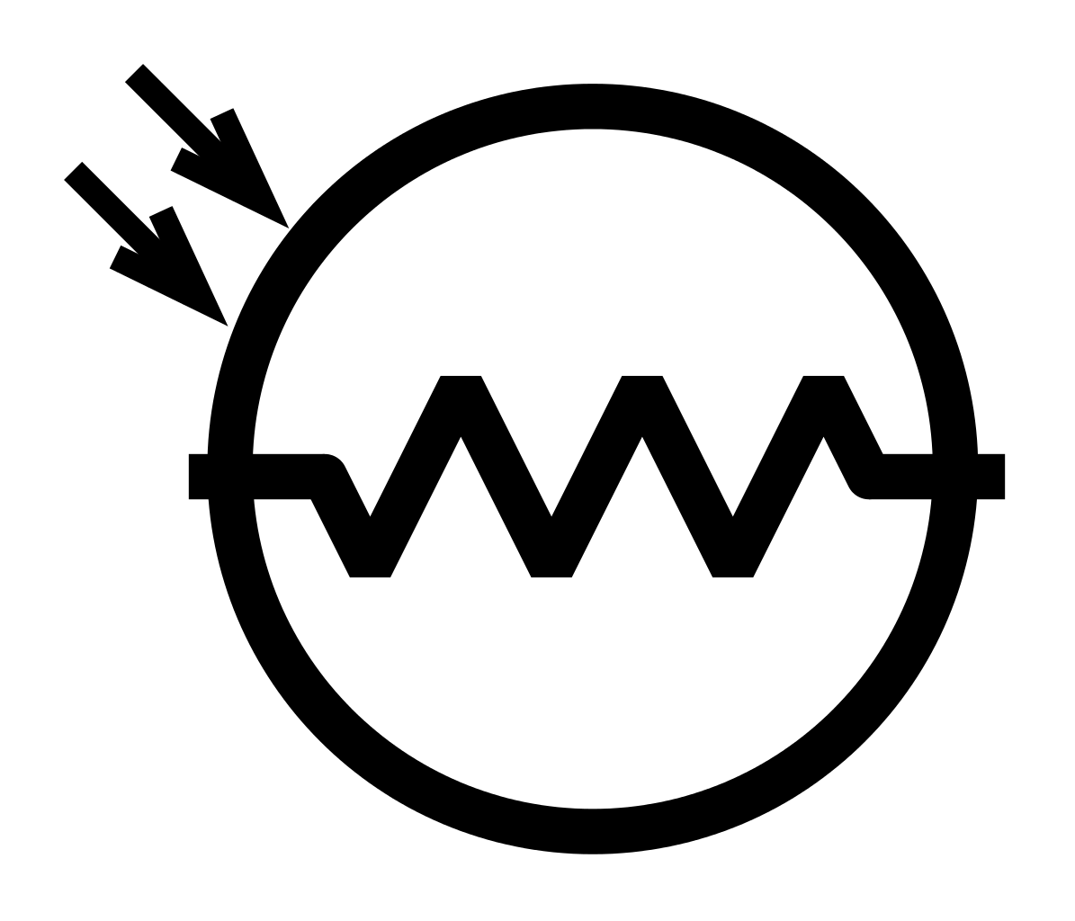
Hardware Workshop: (4 Day Program)
Phase Three: Application Part 1
DC Motors
Pulse Width Modulation
H-Bridge
Photoresistors
Phototransistors
Colour Detection

Slide 7
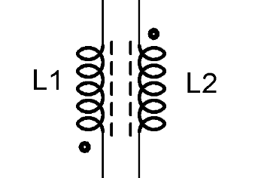
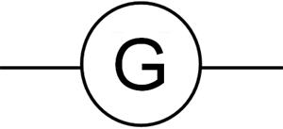
Hardware Workshop: (4 Day Program)
Phase Four: Application Part 2
Coupled Inductors
Joule Thief
Generators
Workshop Competition

Slide 8
Resistor, Capacitor & Inductor
Review

Slide 9
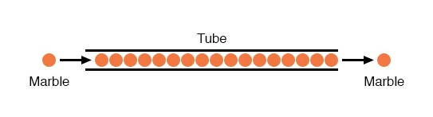
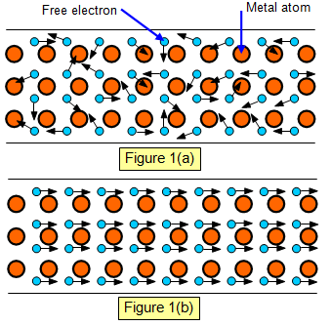
Free Electron
Current is the flow of charge
Free electrons carry charge
Number of free electrons determines conductivity of a material
Current (I, i) is charge in motion
Conventional current is in the opposite direction of electrical current

Slide 10
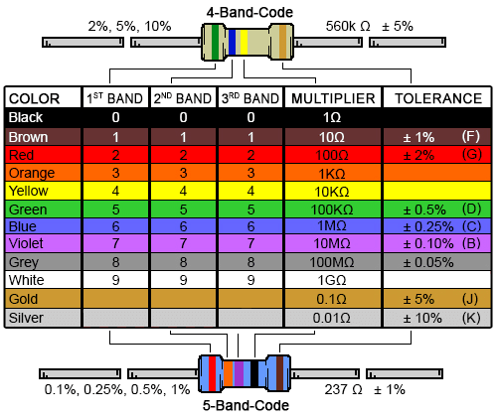
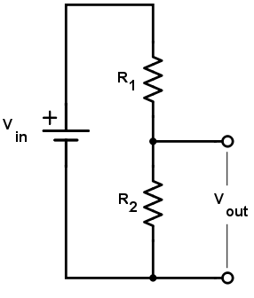
Resistor
Opposes flow of current
Usage:
Limits current
Turns current into voltage
Works as a Voltage Divider

Slide 11
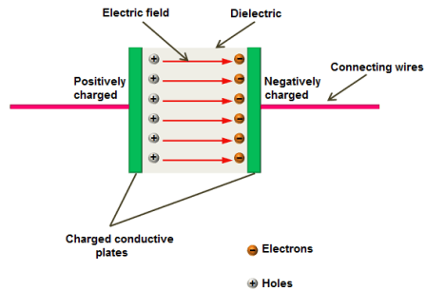
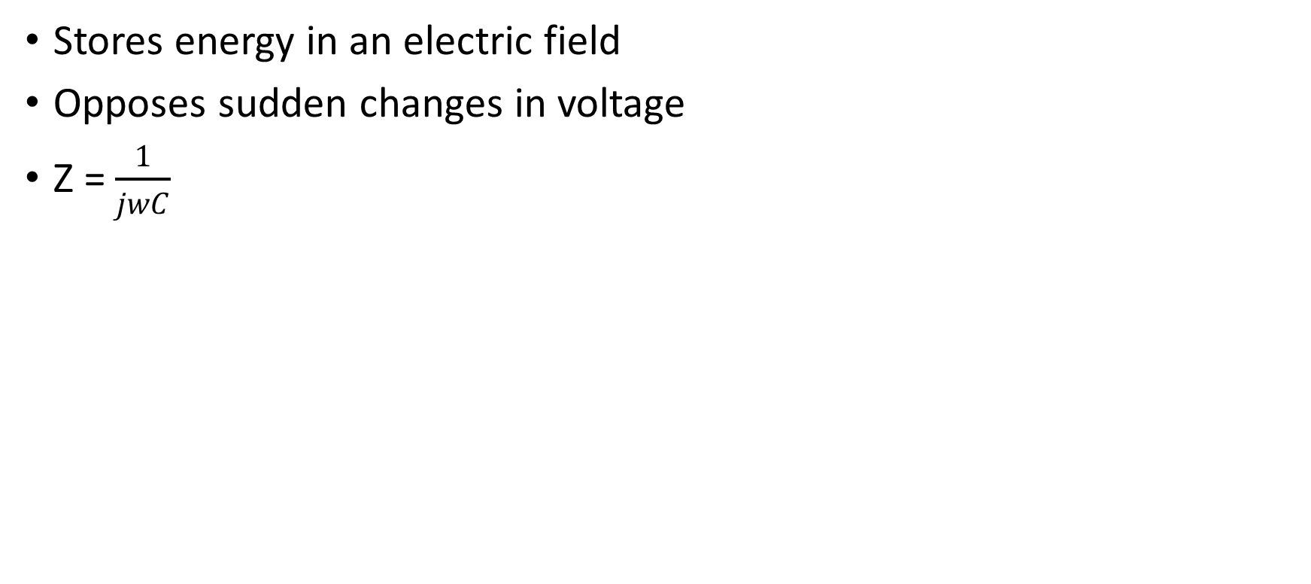
Capacitor
Stores energy in an electric field
Opposes sudden changes in voltage
Z = $\frac{1}{jwC}$

Slide 12
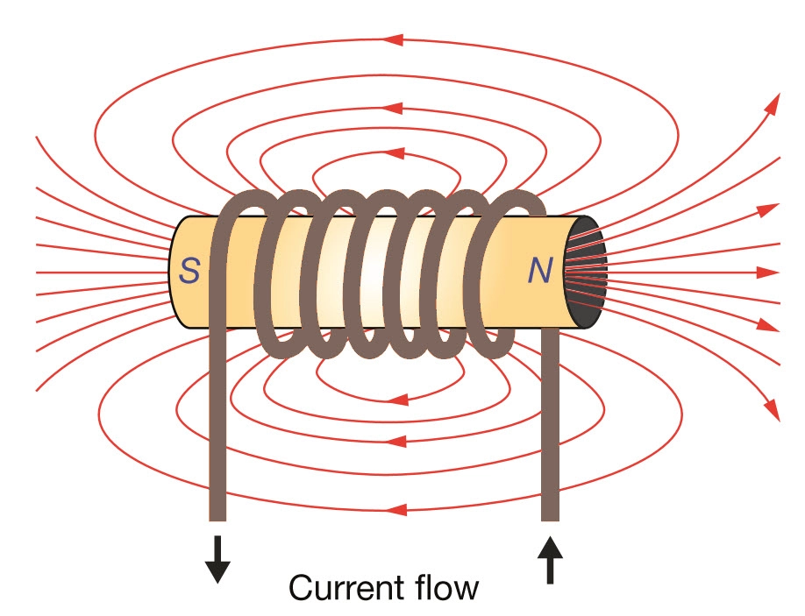
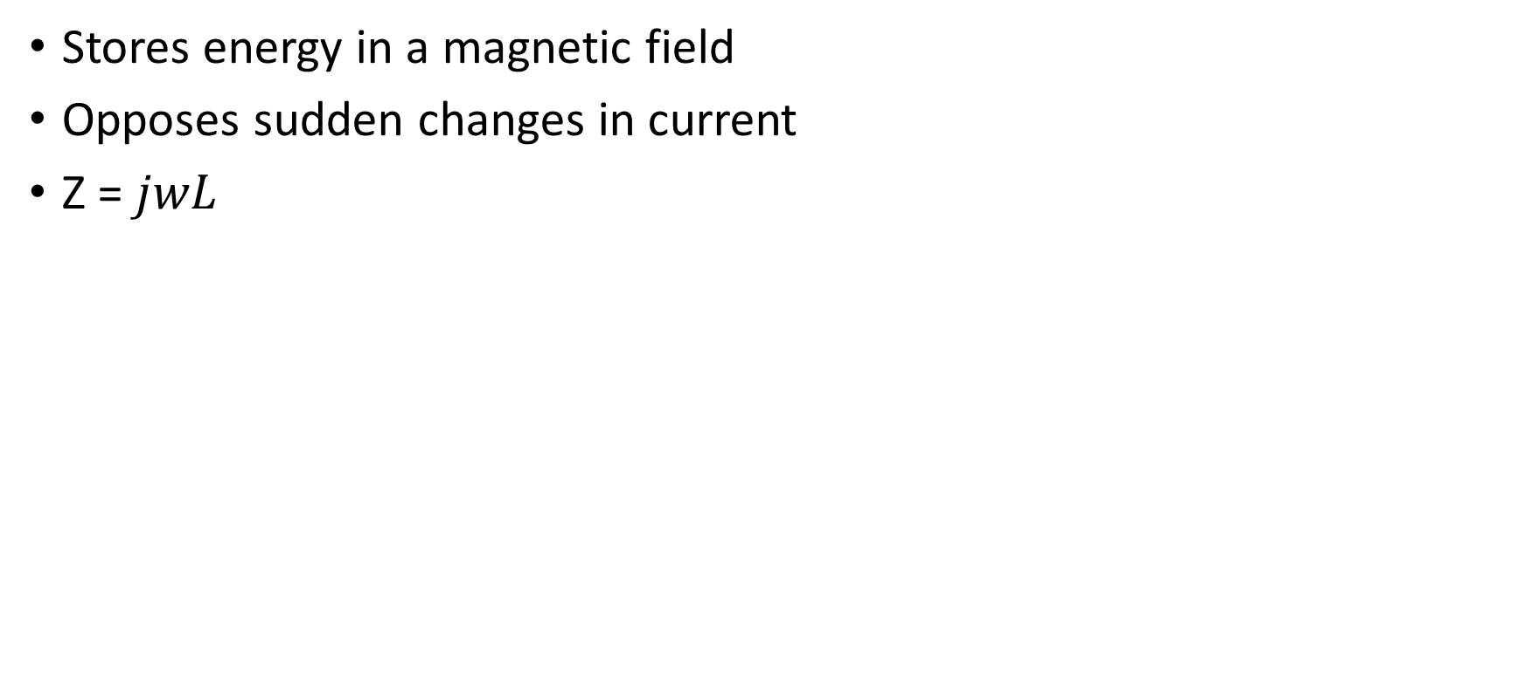
Inductor
Stores energy in a magnetic field
Opposes sudden changes in current
Z = $jwL$

Slide 13
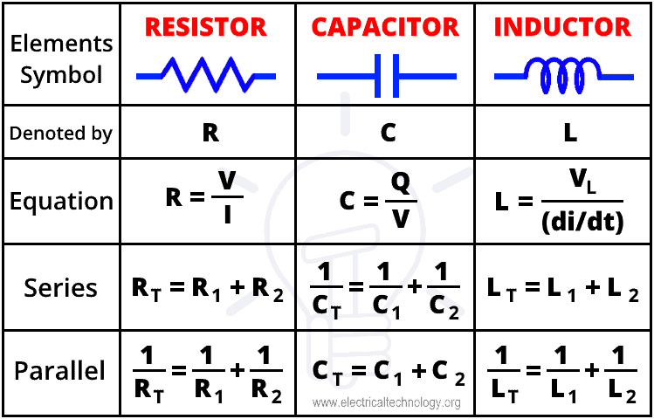
Series and Parallel Connections

Slide 14
Digital Multi-Meter (DMM) & Breadboard
Review

Slide 15
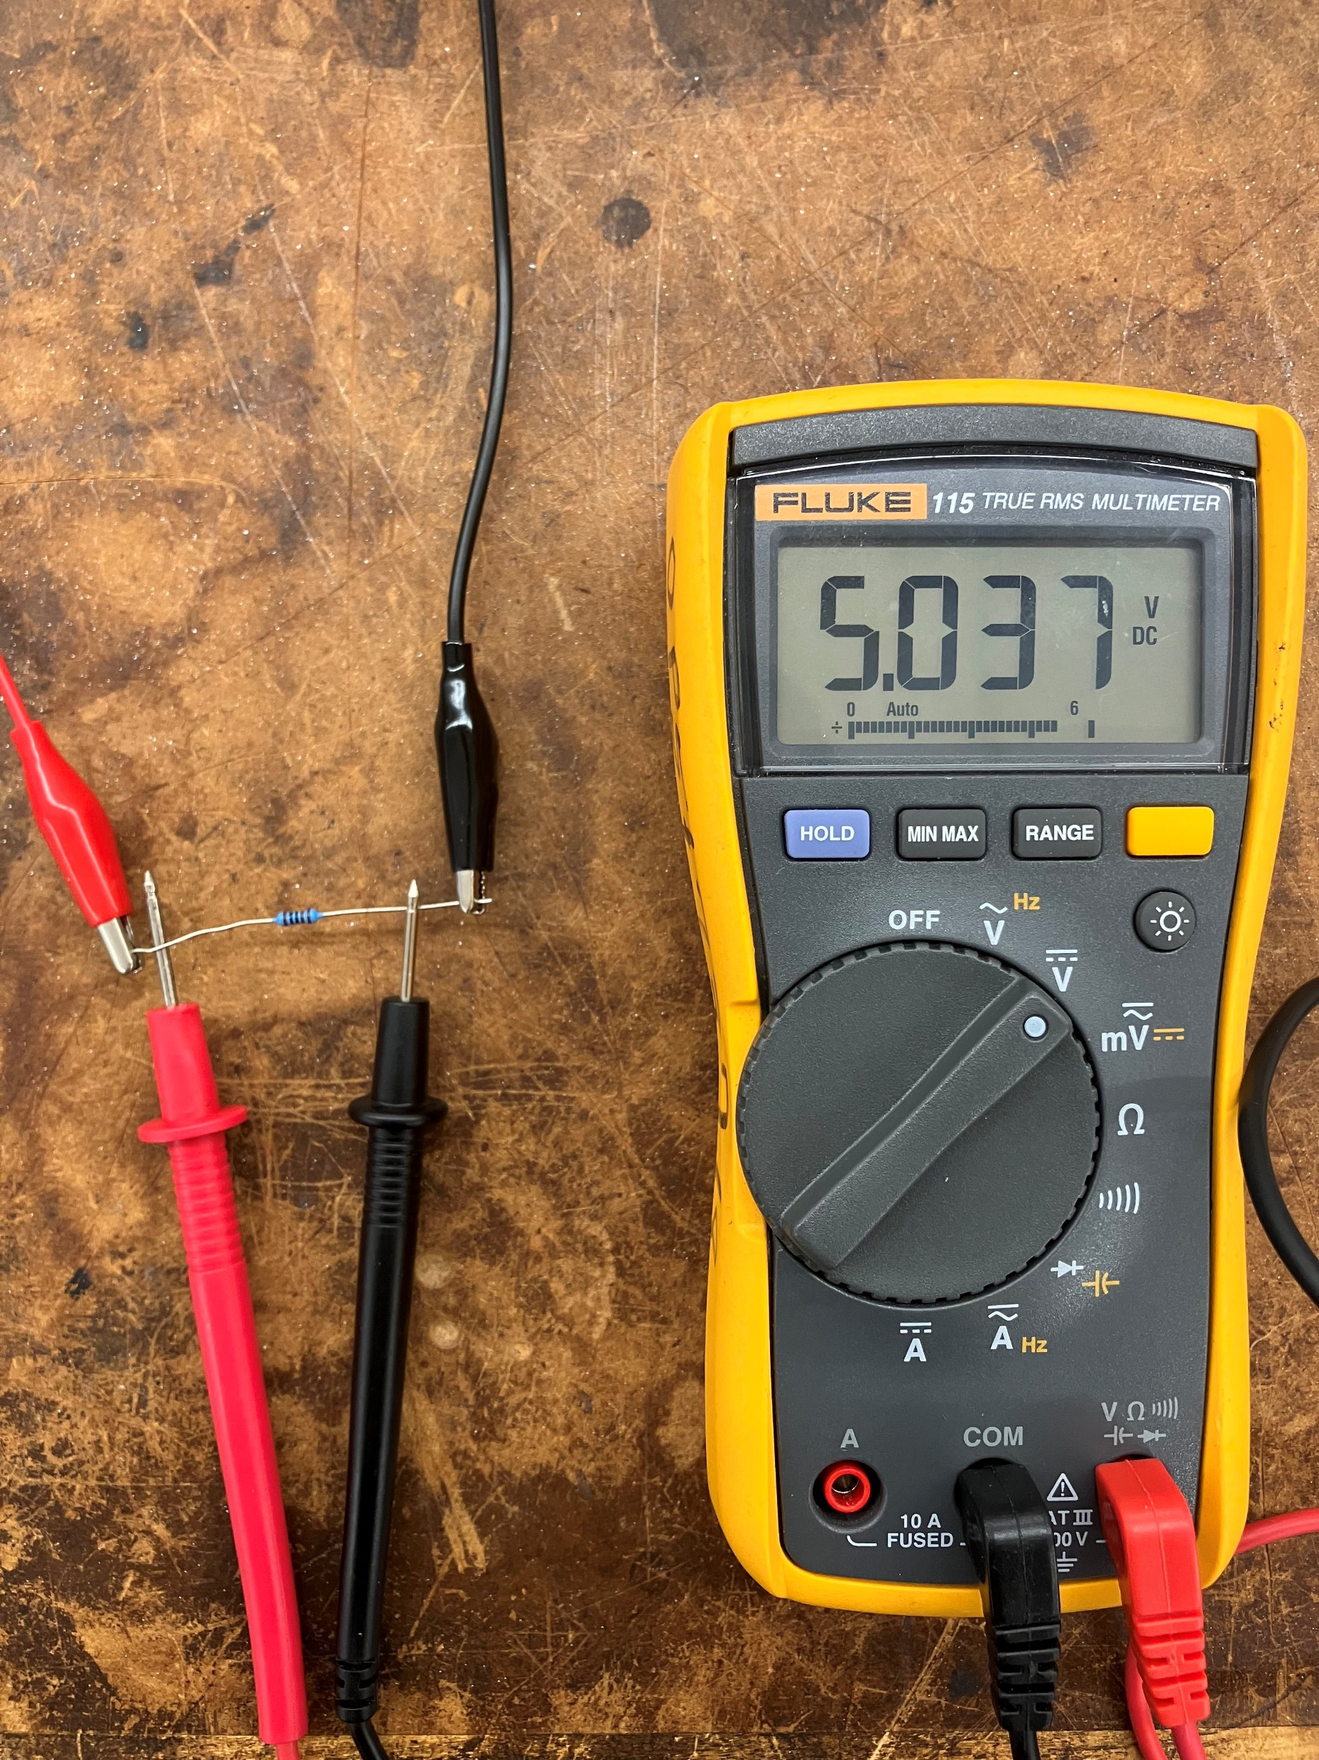
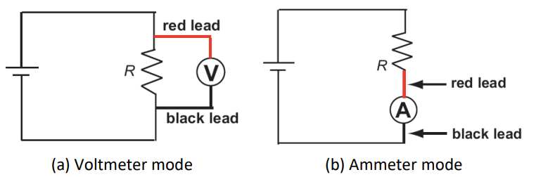
DMM
Using the DMM as a Voltmeter
Plug Red Probe into V/Ω
Select AC/DC based on type of measurements
Connect the Voltmeter in parallel with the circuit
The DMM will measure the voltage across its probes

Slide 16
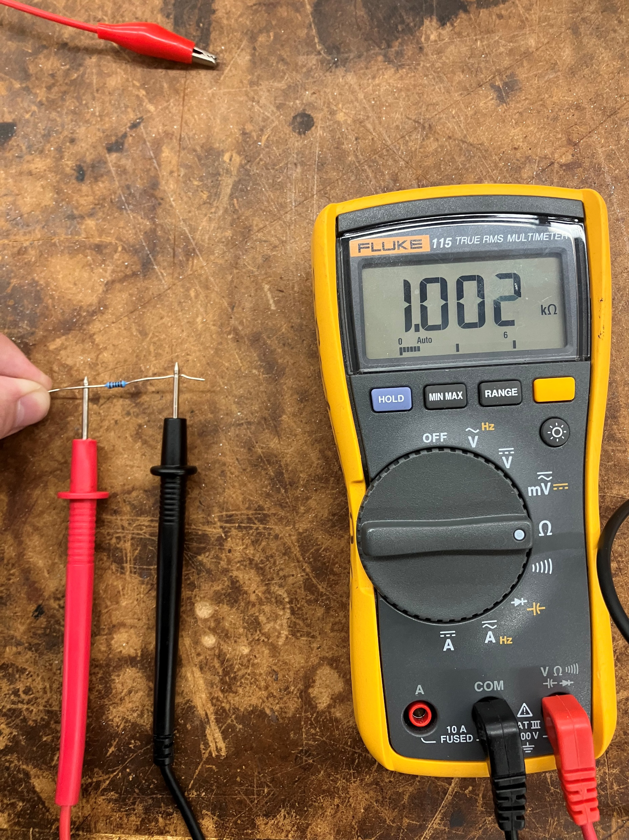
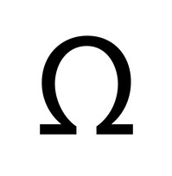
DMM
Using the DMM as an Ohmmeter
Plug Red Probe into V/Ω
Connect the Ohmmeter in parallel with the circuit with no source
The DMM will measure the resistance between its probes

Slide 17
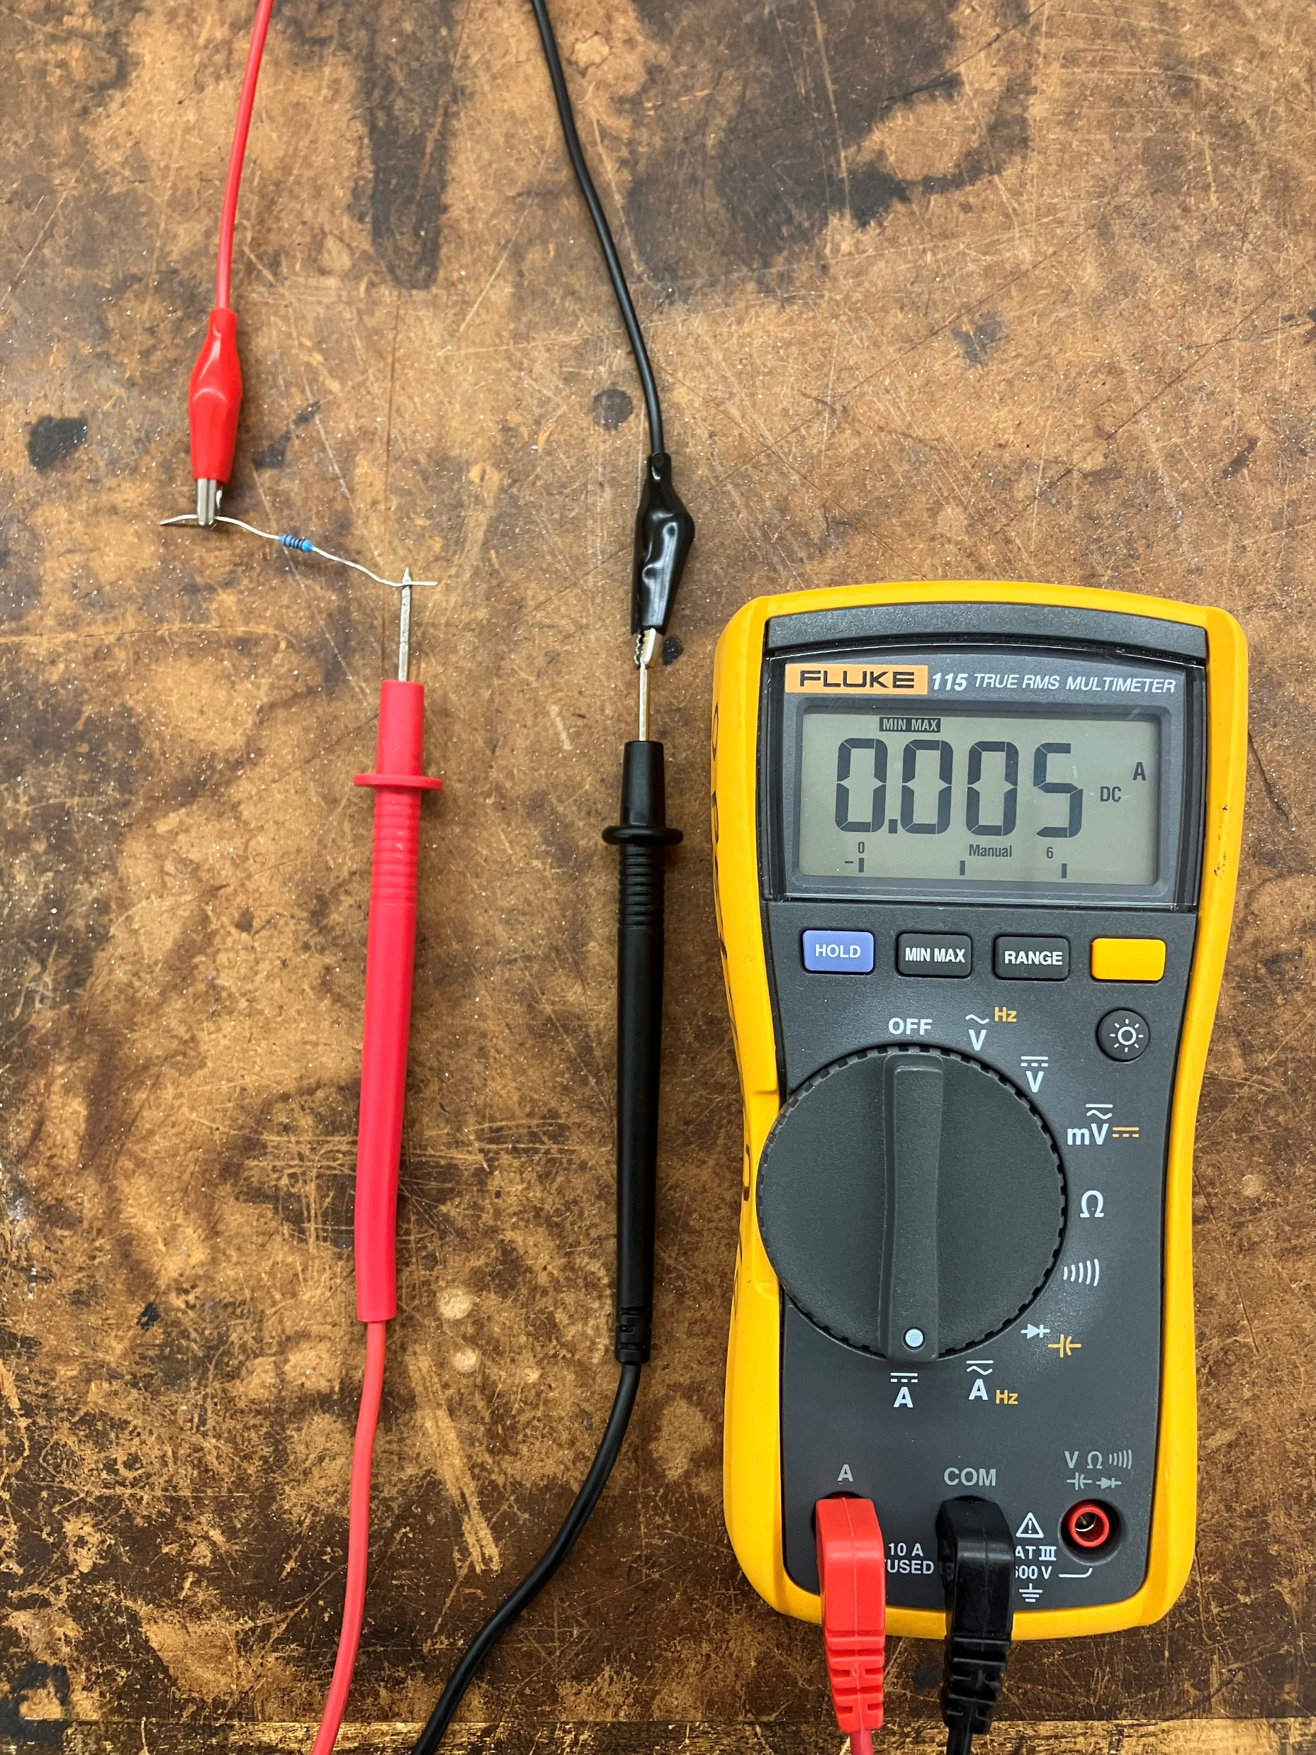
DMM
Using the DMM as an Ammeter
Plug the Red Probe into A
Select AC/DC based on type of measurements
Connect the ammeter in series with the circuit
The DMM will act as a short and measure the current through its probes

Slide 18
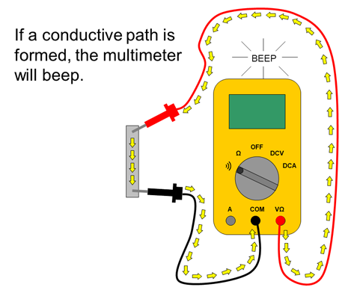
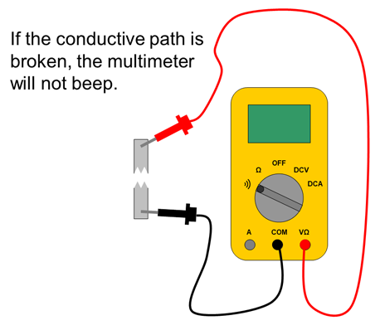
A1: Breadboard Connections
Use the continuity test on the digital multi-meter to find out how the breadboard is connected

Slide 19
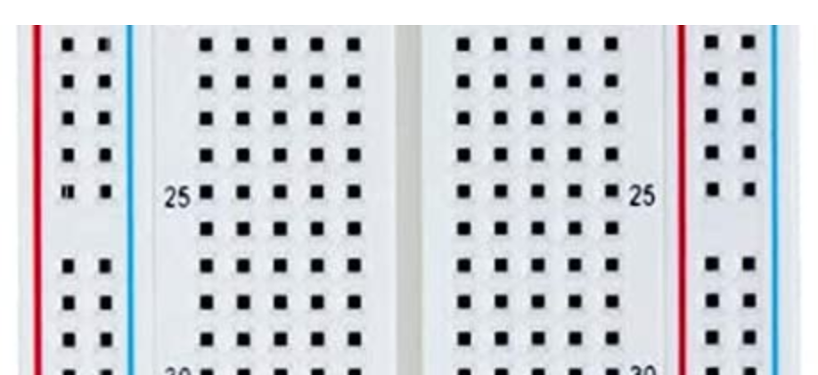
A1: Breadboard Connections

Slide 20
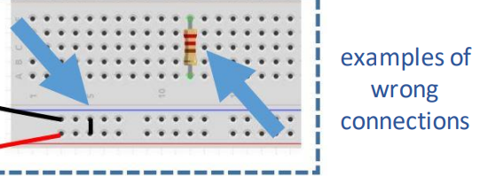
A1: Breadboard Connections

Slide 21
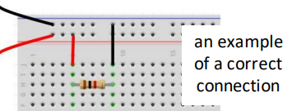
A1: Breadboard Connections

Slide 22
New
Soldering

Slide 23
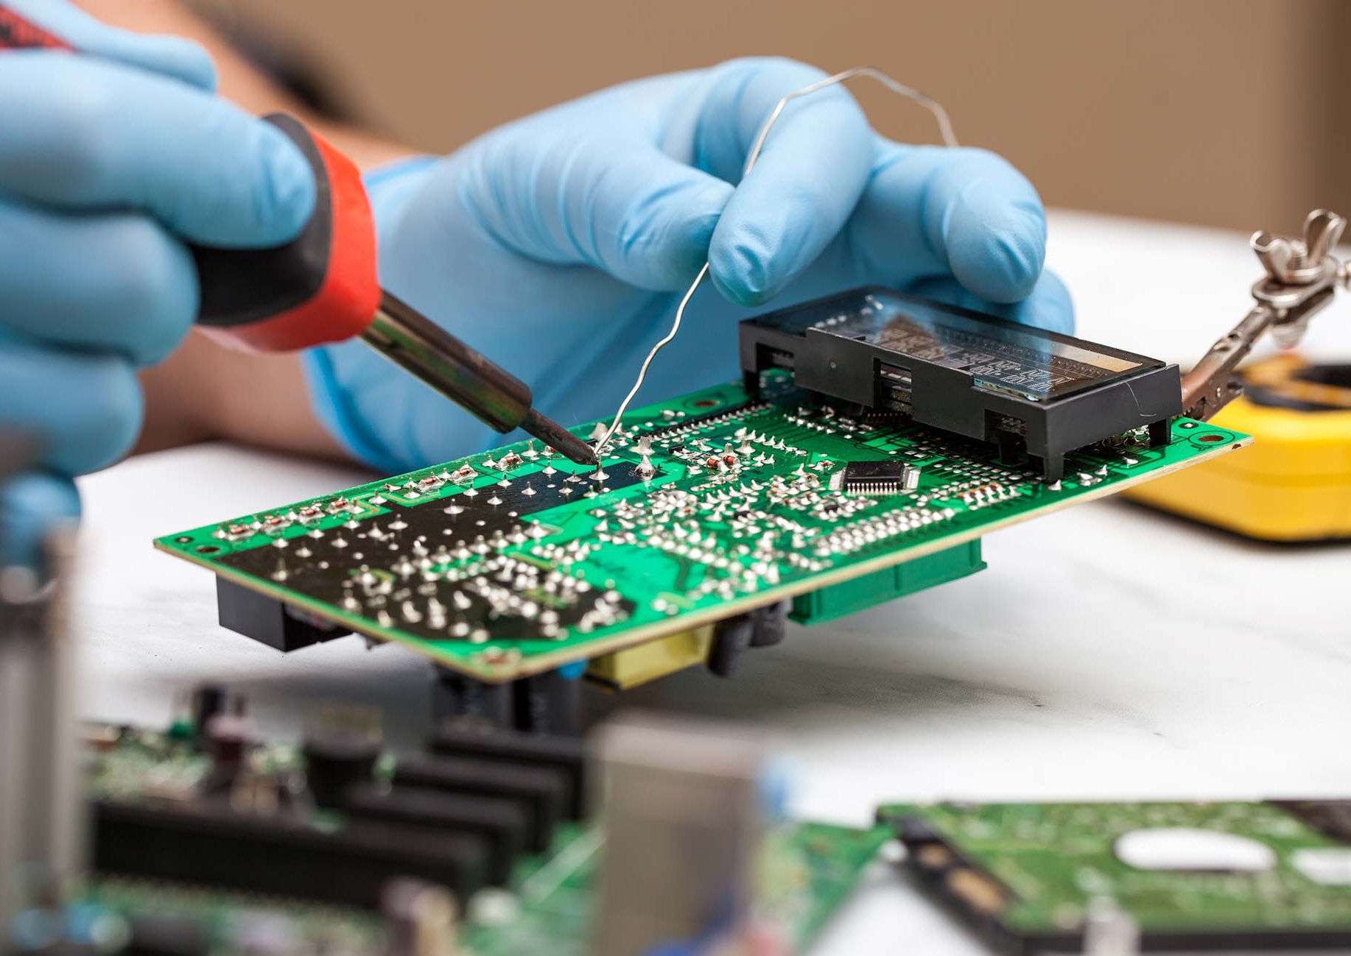
Soldering
The process of joining different types of metal by melting solder and using it as a kind of glue
You’ll need a soldering iron, soldering station, and helping stand

Slide 24
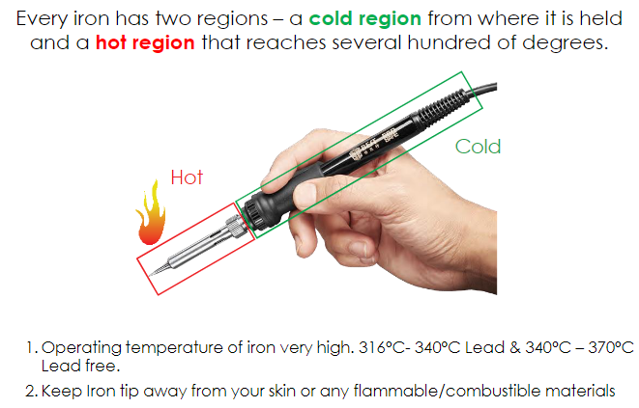
Soldering Iron
Used to melt the solder and heat the two wires you are connecting

Slide 25
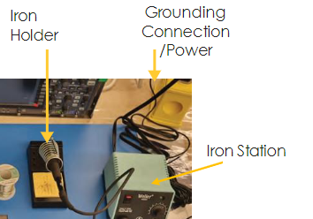
Soldering Station: Safety
Safety standards when using a soldering iron
Always assume the iron is hot
Put the iron back to the station’s iron holder after use
Make sure any components being soldered together are disconnected from any power source

Slide 26
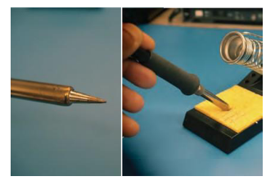
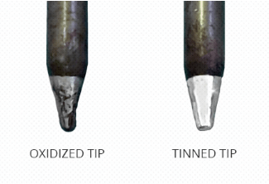
Soldering Station: Clean tip
Clean the tip before use
Use iron holder’s wet sponge or brass sponge to remove the oxidation on the soldering iron tip
Oxidation does not allow heat to transfer, hence, resulting in a poor connection dubbed “cold solder”

Slide 27
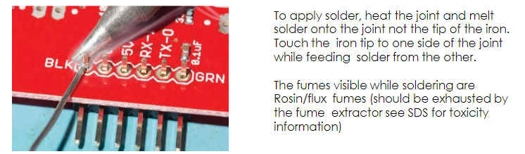
Soldering: The Process

Slide 28
A2: Soldering Practice
Solder at least 4 resistors together to make the first letter of your name
As a requirement of your design, ensure you use at least 2 resistors of the same value directly in series with each other
Calculate equivalent resistance of your circuit
Verify your calculation with DMM

Slide 29
Review
Oscilloscope & Function Generator

Slide 30
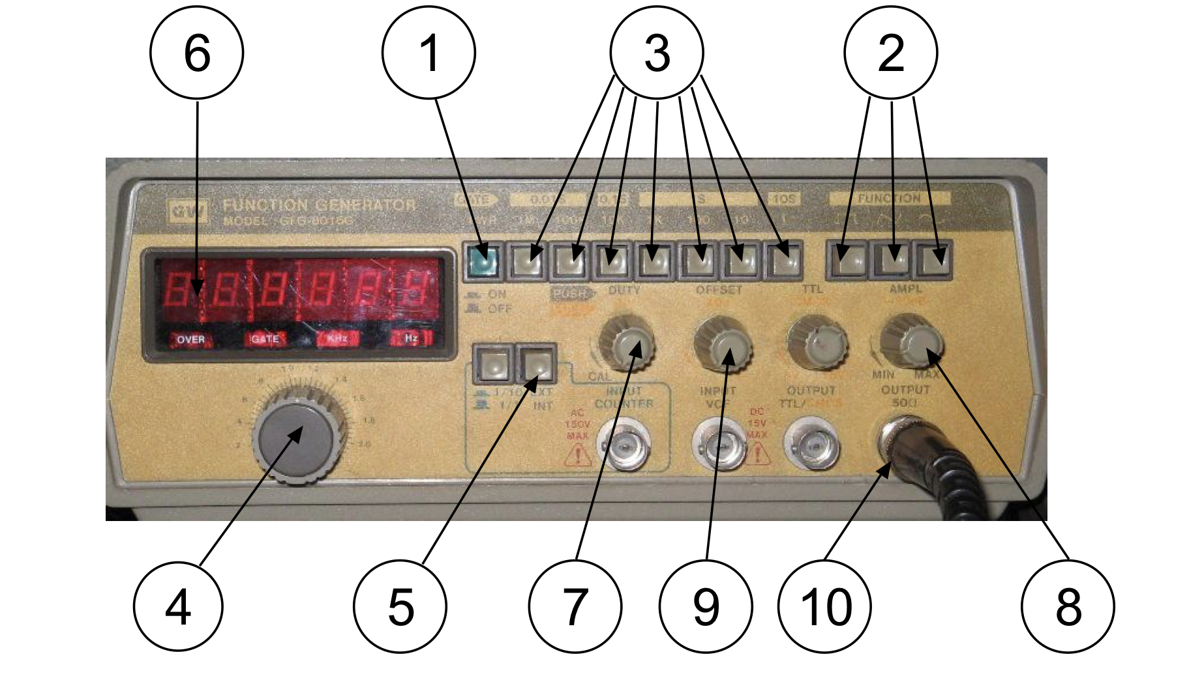
Function Generator

Slide 31
Function Generator
Power button
Signal shape selection
Frequency multiplier switch
Frequency dial
EXT/INT selector
Frequency display
Duty Control
Amplitude control
DC Offset control
Output BNC connector

Slide 32
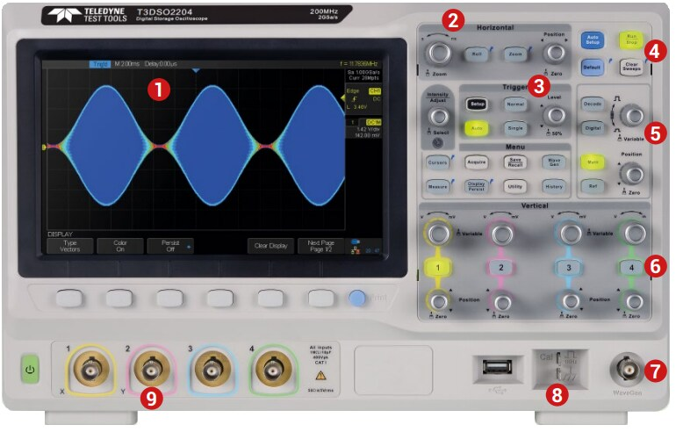
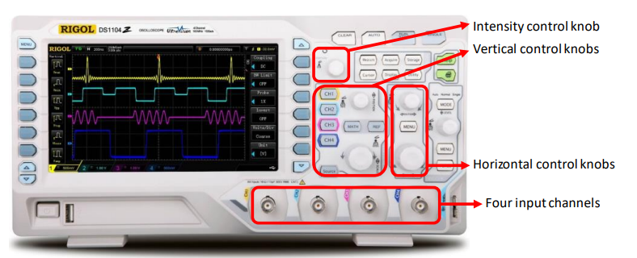
Oscilloscope: Models
There are many models with the same basic functionalities but may offer different features

Slide 33
Oscilloscope: Usage
Determining the frequency, amplitude, phase of a signal, which is critical when debugging a circuit
Identifying how much noise is in the circuit
Identifying the shape of a wave -- sine, square, triangle, sawtooth, complex, etc.
Quantifying phase differences between two different signals

Slide 34
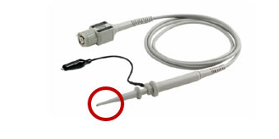
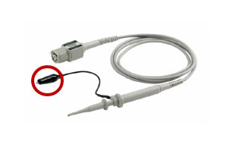
Oscilloscope: Probes
Have the same common ground for all the probes
Be aware of the probe scaling (multiplication factor)
Attach the tip to the signal to be measured
Attach ground clip to a known ground

Slide 35
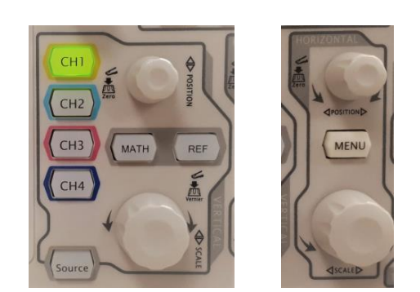
Oscilloscope: Adjusting
Adjusting position and scale of the signal
Vertical Control:
Set value per grid division to display
horizontal Control:
How many seconds per grid division are displayed

Slide 36
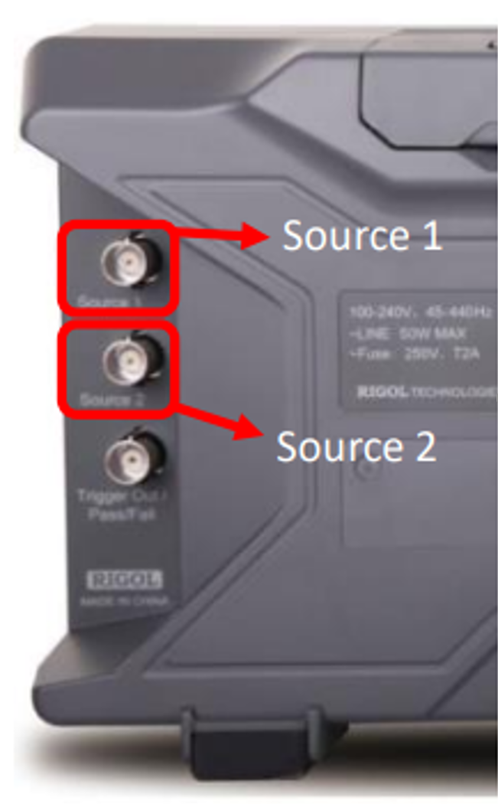
Oscilloscope: Built-in Function Generator
Create a signal
Select source
Select parameter with intensity knob
Turn output on
Metal BNC connectors labeled source 1 & 2
Outputs of the integrated signal generator

Slide 37
Oscilloscope: Final Tips
Things to keep in mind:
Check if the multiplication factor on the probe matches the setting on oscilloscope
Properly connect the ground of the probe
Adjust to proper scale to see the signal
If in doubt can use the “Auto” setup as a starting point

Slide 38
A3: Voltage Divider
Use the built-in function generator of the oscilloscope to produce a 2V peak-to-peak 10kHz sine wave and measure it using the oscilloscope
Use the previous circuit you soldered as a voltage divider, with the intention of halving the amplitude of the input signal. Recall its unique design specification. Measure this output signal
Use the oscilloscope’s cursors to verify the frequency and the amplitude
Notes:
Can provide a quick demo

Slide 39
Hardware Workshop One Fundamentals
Day 1 End

Slide 40
Hardware Workshop One Diodes, Transistors and OpAmps
Day 2 Start

Slide 41
Diode
New

Slide 42
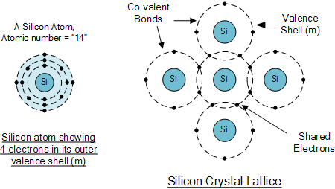
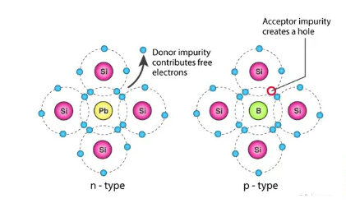
Semiconductor
Commonly used semiconductor: silicon and germanium
Doped into N-type or P-type semiconductor
Useful for PN junctions
Charge carrier: electrons or holes that contribute to the flow of current
N-type charge carrier: electron
P-type charge carrier: hole

Slide 43
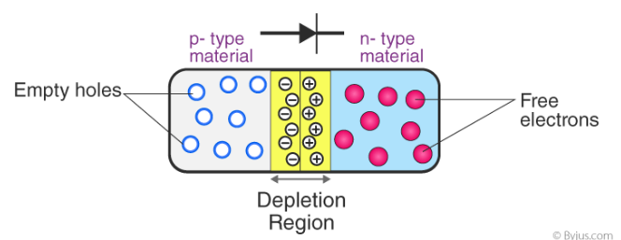
Semiconductor: PN Junction
Depletion region creates boundary inhibiting electron movement when unbiased.
A voltage is required to overcome the boundary inhibiting electron movement (forward bias).

Slide 44
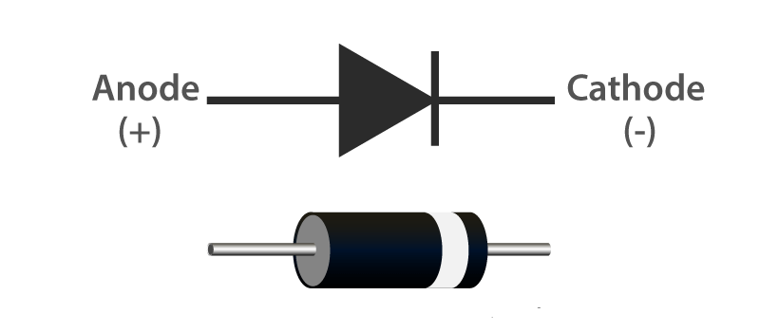
Diode
Only allow current to pass in one direction
Basically a PN junction
Forward voltage required to overcome depletion region (typically 0.7V)

Slide 45
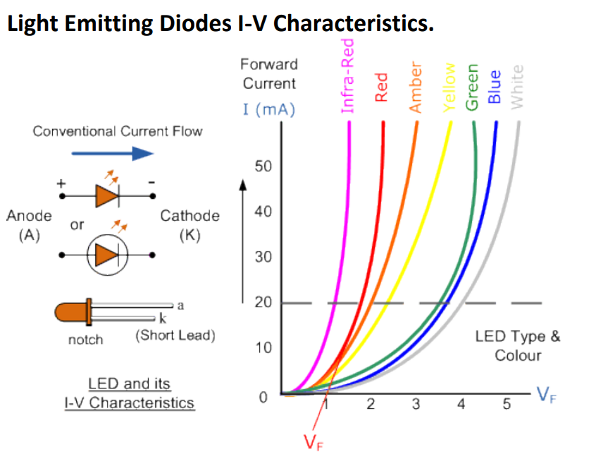
LED (Light Emitting Diode)
Act like a diode but emit light when on
Require higher voltage to turn on (2.8 – 3.6V)
Made of gallium arsenide and gallium phosphide whose electrons emit light when transferring energy

Slide 46
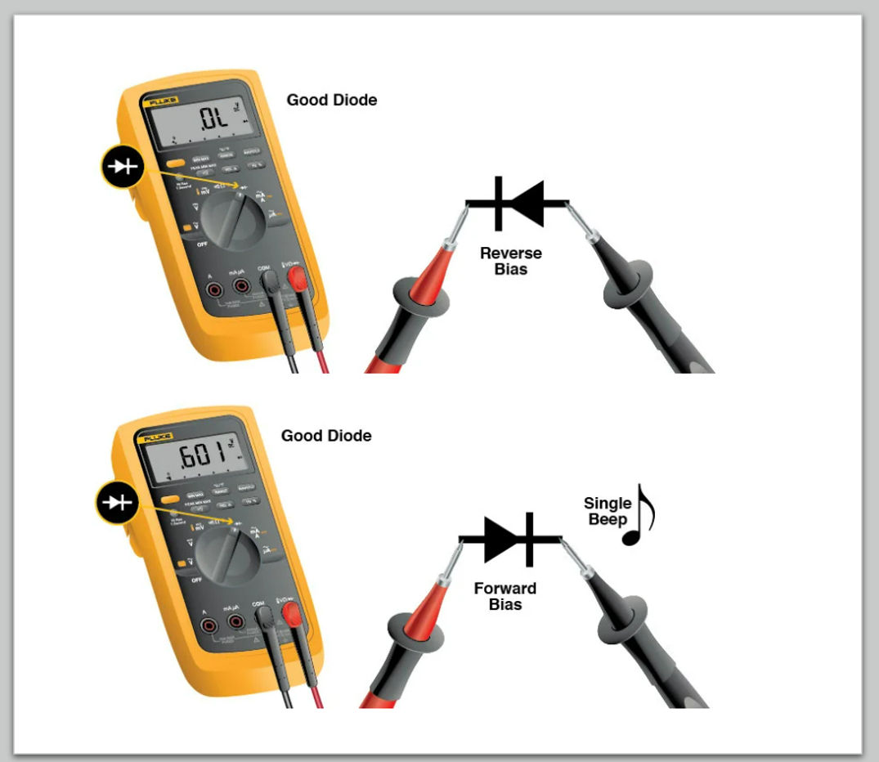
A4: Testing Diodes by DMM

Slide 47

A5: Half-Wave Rectifier
Try to use one diode to turn AC into only one polarity.
Measure the waveform of the output using oscilloscope.

Slide 48


A5: Full-Wave Rectifier
Challenge now: Can you build a rectifier which turns the other half into the same polarity?

Slide 49

A5: Full-Wave Rectifier

Slide 50
Transistor
New

Slide 51

Transistor
Transistor is a semiconductor device used as a switch or to amplify electronic signals
Transistors are widely used in modern electronics
Types of transistor:
Bipolar junction transistor (BJT)
Metal-oxide-silicon field effect transistor (MOSFET)

Slide 52


Transistor (BJT)
Stack of doped semiconductor materials (NPN or PNP junctions)
Base-Emitter junction controls the flow of current
Can be used as switch or amplifier depends on mode of operation.

Slide 53

Transistor - BJT Operation Regions
Cut-Off: (Off Switch Region)
Base-Emitter and Base-Collector junction are both reverse biased
No current through Collector to Emitter
Saturation: (On Switch Region)
Base-Emitter and Base-Collector junction are both forward biased
Low impedance from Collector to Emitter
Active: (Amplifier Region)
Base-emitter forward biased and Base-collector reverse biased
Amplification of current controlled by Base-Emitter voltage

Slide 54

A6: Astable Multivibrator
Produces square waves
Uses transistor as the switch to charge and discharge capacitors

Slide 55

A6: Astable Multivibrator

Slide 56

A6: Astable Multivibrator

Slide 57

A6: Astable Multivibrator

Slide 58

A6: Astable Multivibrator with LED Output (SWAP WITH LIVE DEMO)

Slide 59
New
Operational Amplifiers

Slide 60

Operational Amplifier (Op Amp)
Z_{in} → ∞ Ω (open circuit)
Z_{out} → 0 Ω (short circuit)
A → ∞ (very large gain)
Output is capped by the V+/- rails in the top and bottom that power the Op Amp

Slide 61

Op Amp: Stabilizing Output
Negative feedback
Make the Op Amp dependent on the feedback of the output
Gives us some control in influencing the Op Amp’s output through modifying the negative feedback wire
Use the input current to the +/- nodes = 0, voltages of the +/- nodes are a virtual short (V₊ = V₋), and KCL analysis to do this

Slide 62

Op Amp: Configurations

Slide 63


A7: Building Amplifiers
Try to build an inverting amplifier with Gain bigger than 5. What happens?
Build a summing Op Amp with 2 inputs and V_{out} = -(V₁ + V₂)

Slide 64
A8: Amplifying Astable Multivibrator
Consider the Astable Multivibrator with only a 2.0V source
Enough to charge and switch the transistors but not enough to power the LEDs
Add an amplifier to one side of the circuit to make one LED flash on and off, while the other does not

Slide 65
Hardware Workshop One Diodes, Transistors and OpAmps
Day 2 End

Slide 66
Hardware Workshop One Motor Control and Light Sensors
Day 3 Start

Slide 67
DC Motors

Slide 68


Modelling DC Motors
Current flows into the motor
Magnetic force is generated to spin the shaft
How can we model this system?
Notes:
We will talk more about Faraday’s Law tomorrow

Slide 69

Modelling DC Motors
What direction will the motor spin?

Slide 70

Modelling DC Motors: Important Attributes
We need to be able to implement:
1. Variable Speed
2. Variable Direction

Slide 71


Pulse Width Modulation (PWM)
What happens if I pulse my DC input voltage on and off very, very quickly?
Light gets dimmer, as ON pulses get shorter and OFF pulses get longer
Notes:
Reference spikes

Slide 72
A9: Play with PWM and Motors
Set up a PWM signal (10kHz, 10V) on your function generators and connect it directly to a DC motor
Adjust the Duty Cycle of the PWM signal and observe how the RPM of the motor changes

Slide 73
H-Bridge

Slide 74

So Far, Only One Direction
How can we control the direction that the motor spins?
Solution: H-Bridge Circuit
NPN Transistors
Notes:
How we can control which way the current flows through the motor
Model switches with transistors

Slide 75


Modelling DC Motors
What happens if we provide a DC Motor with AC voltage?
The inductor in the motor will store up energy in a magnetic field
When the voltage across it changes rapidly, it will want to discharge that energy, but in reverse polarity to the voltage that was across it
Notes:
Problem with changing voltage quickly
Current needs time to change
Results in Voltage Spikes if the current has nowhere to go -> damage transistors

Slide 76

Flyback Diodes
How do we prevent the motor’s inductance spikes from damaging our transistors?
Solution: Flyback Diodes

Slide 77
A10: Build a Winch
We can use an H-bridge circuit with
NPN transistors modelled as our switches
Resistive loads to mitigate shoot-through situations
Flyback diodes to manage inductive spikes
Now let’s build it: Build an H-bridge with V_{cc}: 10V power supply using the function generator and your DC Power Supply to power your switches.
Recall not to cause a shoot through scenario by powering SW1 and SW2 / SW3 and SW4 at the same time, as this will damage your transistors

Slide 78
A11: Build a Better Winch
How can we incorporate variable speed with PWM like we learned before into our H-Bridge Circuit?

Slide 79
Light / Colour Detector

Slide 80


Variable Resistors: Potentiometers
Allow for resistance to be controlled by some external variable
10K Potentiometer (POT)
Ranges from 0 – 10kΩ
Pins 1 -> 3 are set 10kΩ
Pins 2 -> 1 or 2 -> 3 is a variable resistance depending on where the wiper is
More track between pins = More resistance

Slide 81
Variable Resistors: Photoresistors
Photocells, Light Dependent Resistor (LDR)
Allows for resistance to be controlled by light
More light = Less resistance
More dark = Larger resistance

Slide 82

Photoconductive Effect
Photoconductive Effect: When light shines on a material, electrical conductivity increases
Photons excite electrons -> more energy in material -> more conductivity
Property is prominent in materials like Cadmium Sulfide (CdS Photoresistors)

Slide 83

A12: Build a Phototransistor to Detect Colour
Use both a potentiometer and photoresistor to tune a transistor to light up an LED only when a specific colour is detected
Note: Colours absorb other lighter colours and reflect other darker colours

Slide 84
Hardware Workshop One Motor Control and Light Sensors
Day 3 End

Slide 85
Hardware Workshop One Generating Power
Day 4 Start

Slide 86
Coupled Inductors

Slide 87

Coupled Inductor
Two coils are placed nearby or winded on the same core
Magnetically coupled
Magnetic core holds the magnetic flux
The same magnetic flux pass through two coils
Change of magnetic field in one coil will induce current in the other coil.

Slide 88

Coupled Inductor
Dot convention:
With the same direction of magnetic flux, current flows into the dot
Aiding mode:
Dot at the same side
Opposing mode:
Dot at opposite side.

Slide 89


Coupled Inductor

Slide 90


A13: Coupled Inductor
Wind an aiding mode coupled inductor on a ferrite core and measure the primary & secondary side voltage using oscilloscope
Wind an opposing mode coupled inductor on a ferrite core and measure the primary & secondary side voltage using oscilloscope

Slide 91
Joule Thief

Slide 92


A14: Joule Thief
The joule thief is a self-oscillating voltage booster using coupled inductor.
Convert constant low voltage to a periodical higher voltage.
Typically used to drive small loads

Slide 93
Generators

Slide 94

Hand Crank: Mechanical Energy
Works through application of Faraday’s Law
Rotate the wheel with your hand via a crank
Rotation of the magnets relative to the wound-up wire induces a current within wire
Faster rotation = Faster movement through magnetic field = Stronger induced current

Slide 95

Solar Panels: Solar Energy
Photovoltaic Effect:
Photons will excite electrons in the depletion zone of PN junction
Split electrons and holes are pushed to their respective sides
This creates a small potential difference across the junction
Put enough photovoltaic cells in series or parallel with each other and you can get a substantial voltage
Notes:
Recall PN junctions and photoconductive effect

Slide 96
Day 4 Competition

Slide 97
Competition Outline (subject to change atm)
Generate the highest possible voltage you can from the tools you have been given to power your flashlight
You may use any of the tools / concepts we have covered
Bonus points if you manage to incorporate the Joule Thief circuit into your design in a practical manner
You cannot use the function generator or oscilloscope to generate any voltage

Slide 98
Hardware Workshop One Generating Power
Day 4 End

